Slide 1
Objects and Classes: the basics
Link to this document
Applied Python

Slide 2
What are we doing?
Learning Objectives
By the end of this week, you should:
understand what classes are
identify the difference between class attributes and instance attributes
know the benefits of inheritance
Measurable Outcomes
By the end of this week, you should be able to:
explain how classes relate to objects, as well as the differences between them
write a custom class which inherits from another class
override a parent attribute

Slide 3
CLASSES

Slide 4
First: the object
You've learned about a few datatypes: they're a collection of data, along with some functionality (sometimes), all packed up in the same container. You've also learned about functions: they're a collection of data (sometimes), along with some functionality, all packed up in the same container. Golly gee, that sure sounds similar!
It turns out that both variables (of datatype list, for example) and functions are objects: a container in memory which can hold both data and functionality.
(Note: it also turns out that everything in Python is an object. More on that later.)

Slide 5
Classes: abstraction at its best
You've been working with Python's built-in datatypes since the beginning of the semester. Some of them even have built-in functionality; they've all been pretty handy. But what happens if you decide you want to hold data and functionality in a way that the built-in datatypes don't already support? What if they built-ins just don't have the right complexity for the type of thing that you're trying to represent?
You'll need to create your own definition for a new datatype, and then make new instances of that new datatype. The new definition is called a class, and the instance is called an object.

Slide 6
Classes and objects: the distinction
An object is simply just a container filled with data as well as actions that can be performed on that data. It turns out that every Strings, dictionaries, lists - every variable you've ever created in Python - is in fact an object.
A class is nothing more than the definition for creating an object. It's got all the properties defined - called attributes - as well as all the actions which can be performed - called methods.

Slide 7
Hold on - I've used these before?
Remember that Strings hold a sequence of characters (data) and there are a whole set of actions that can be performed on that data? That sounds a lot like attributes and methods, yeah? Turns out there is a String class which is used to build new String objects.
Remember that lists hold a sequence of items (data) and there are a whole set of actions that can be performed on that data? That sounds a lot like attributes and methods, yeah? Turns out there is a list class which is used to build new list objects.

Slide 8
Class and Object: two part process
Working with classes and objects is actually very straightforward! Just as there are two parts to working with functions:
Defining the function.
Calling the function.
There are two parts to working with classes:
Defining the class.
Creating a new instance of the class (an object).

Slide 9
Classes: defining
The format of a class is pretty straightforward - it looks a lot like a block of code with internal variables and functions - but there is some nuance, so let's take a dive into it to get a feel for what's what.
To the right you'll see effectively a generic template for a class definition.
class ClassName(object):
def __init__(self, params):
# initialize instance variables
def method(self):
# define this method

Slide 10
Objects: instantiating
Object creation is easy; you've done it before! Just as you can create a new list object from the list Class:
empty_list = list(1, 2) # constructor
empty_list = [1, 2] # shorthand
You can instantiate a new object from your own class by saying its name (and feeding it any arguments it requires).
# class definition
class Student(object):
def __init__(self, name_param, ID_param):
self.name = name_param
self.ID = ID_param
# ...
def main():
# object instantiation
grace = Student('Grace', 35894)
# ...

Slide 11
ATTRIBUTES AND METHODS

Slide 12
Classes: Attributes
Attributes are variables defined in a class. When a new instance of that class is created, that object receives its own copies of those attributes; at that point, they are called instance attributes. Every new instance has its own personal copies.
Every attribute you want to be an instance attribute must be declared in the __init__() method.
class Student(object):
def __init__(self, name_param, id_param):
self.name = name_param
self.id = id_param
self.courses = []
# ...
def main():
student1 = Student('Grace', 35894)
student2 = Student('Bobby', 75855)

Slide 13
Context for clarity
student1 object
name
'Grace'
When you create an instance of a class (otherwise known as an object):
the instance has attributes stored inside
each instance gets its own unique attribute values
ID
35894
Student class
courses
name
instantiation
[]
ID
student2 object
courses
instantiation
name
'Bobby'
ID
75855
courses
[]

Slide 14
What's up with self?
When a new instance of a class (an object) is created, it gets copies of all the attributes defined in the class. In order to signify to the class that a particular variable is going to be copied into every new instance, a new keyword is used: self. self ensures that when an object refers to an attribute, that it is referring to its own personal copy!
Once an attribute is defined, it is scoped to the new object, so it can be accessed from anywhere inside it.
class Student(object):
def __init__(self, name_param, id_param):
self.name = name_param
self.id = id_param
# when a new object is created,
# a personal copy of each variable
# which is preceded by self will be
# given to the new object.
# ...

Slide 15
OK: but what about __init__()?
When instantiating a new object, you call it by its name:
nancy = Student('Nancy', 34567)
What actually happens when you do this? A special method in the class is called: __init__() . It's what is called the constructor*: it constructs the new object from the class structure, as well as any given arguments.
What this means in practice is that you'll need an __init__() method in every class definition. Requirements of the __init__() method:
It must be the first method in the class definition.
It must have self as its first argument.
All instance attributes must be defined inside __init__().
* Technically this method is the initializer, not the constructor. But in Python, you define the initializer for creating new objects, so it is referred to as the constructor anyway.

Slide 16
Putting it all together
class Vehicle:
def __init__(self, make_param, model_param):
self.make = make_param
self.model = model_param
self.odometer = 0
def main():
car1 = Vehicle("Ford", "Fiesta")
car2 = Vehicle("Tesla", "S")
main()
car1 object
make
Ford
car2 object
model
make
Fiesta
Tesla
odometer
model
0
S
odometer
0

Slide 17
Classes: Methods
Methods are functions attached to specific objects. You've seen them before (e.g. list.append() ). They are defined in the class definition. When a new instance of that class is created, that object receives its own copies of those methods; at that point, they are called instance methods. Every new instance has its own personal copies.
Note that self must be the first parameter of any method, for the same reasons that all attributes must be preceded by self. .
Accessing a method is as easy as using the dot operator.
class Student(object):
def __init__(self, name_param, ID_param):
self.name = name_param
self.ID = ID_param
def say_hello(self):
print('Hi! My name is', self.name)
def main():
grace = Student('Grace', 35894)
grace.say_hello()
>>> Hi! My name is Grace

Slide 18
Classes: Class Attributes
Occasionally, you might want data which is accessible to every instance of a class. Class attributes are variables which are accessible to any and all instances of that class - they are shared across all instances. When a new instance of that class is created, that object can access the class attribute. It's also accessible to the class itself.
You access a class attribute with the ClassName plus the dot operator.
class Student(object):
num_students = 0
def __init__(self, name_param, ID_param):
self.name = name_param
self.ID = ID_param
Student.num_students += 1
def say_hello(self):
print('Hi! My name is', self.name)
def main():
grace = Student('Grace', 35894)
nancy = Student('Nancy', 34567)
print(Student.num_students)
>>> 2

Slide 19
Attributes: accessing
You know that you access an object's methods using the dot operator. But how do you access their attributes? It turns out that you can use the same technique: the dot operator. But this can have unintended consequences.
class Student(object):
def __init__(self, name_param, crss_param):
self.name = name_param
self.ID = ID_param
self.courses_list = crss_param
grace = Student('Grace', 35894, ['ITP-216', ITP-449'])
def main():
print(grace.courses_list[0])
print(grace.courses_list[2])

Slide 20
Attributes: getters and setters
What you really need is a way to do error checking so that your program doesn't crash when the user tries to access or change attributes incorrectly. The solution is with two tools:
Getter: a method which will error check input and return an attribute.
Setter: a method which will error check input and change an attribute.
Convention dictates that you should only provide a getter for an attribute you want a user to be able to access, and only provide a setter for an attribute you want a user to be able to modify.

Slide 21
Attributes: getters and setters
So a solution to the issue from before is to add a getter for the particular attribute in question. For either getters or setters, the convention you should be using for this course is to precede a getter with get_ and a setter with set_ .
class Student(object):
def __init__(self, name_param, crss_param):
self.name = name_param
self.ID = ID_param
self.courses_list = crss_param
def get_course(self, index):
if index < len(self.courses_list):
return self.courses_list[index]
else:
return 'Index', index, 'out of range.'

Slide 22
Methods: dunders
A final note on methods: there are a whole host of other double-underscore (dunder) methods that can be implemented in your classes. Just like __init__(), all dunder methods are called automatically in certain scenarios. It's why they are also sometimes called ‘special methods'.
There are only a small handful that will be covered in this course, but there are many that can be used.

Slide 23
Side note: underscores
You know that you can add underscores to variable and function names. But there is also a convention for when leading and trailing underscores are added to names of any object in Python:
_obj_name : protected. Don’t directly change me (convention, not enforced by interpreter)!
__obj_name: private. Don’t directly access me (name mangled)!
__obj_name__ : built-in, special object.
If a function: don’t directly call me, I get called automatically at the appropriate time
If a variable: don't directly change me, my value was already set

Slide 24
Dunder methods: __str__()
When you go to print an existing object, you may be greeted with something like the following:
grace = Student('Grace', 35894)
print(grace)
>>> <__main__.Student object at 0x7fb548124c40>
So to fix it, just add the __str__() method definition in the class. This method is called automatically when an object is inside a print statement. It should return a string.
class Student(object):
# ...
def __str__(self):
return 'The student ' + self.name + ' has an ID of ' + str(self.ID)
grace = Student('Grace', 35894)
print(grace) # calls grace.__str__()
>>> The student Grace has an ID of 35894

Slide 25
Class Creation Checklist
__init__()
define instance attributes and initial values
__str__()
what will this thing look like printed out as a string?
getters and setters
encapsulation, what are valid values? think hospital/operation
separate implementation from interfaces
separate method bodies from method signatures

Slide 26
INHERITANCE

Slide 27
Inheritance: the basics
Inheritance is a property of classes that allows you to define a class which inherits all attributes and methods from another class. It is a parent/child relationship:
The parent class defines a set of features. It is the class being inherited from. (It can also be called the base class or super class.)
The child class acquires features from the parent. It is the class doing the inheriting. (It can also be called the derived or sub class.)

Slide 28
Inheritance: wait but why?
Remember one of the fundamental tenets of programming: DRY (Don't Repeat Yourself). Inheritance helps reduce code duplication between similar classes. It also helps to abstract functionality.
The parent provides a basis for all the children, and the children build upon or refine the Parent.

Slide 29
Inheritance: syntax
Any class can be a parent class. The syntax for a Parent class is the same as always:
class Parent(object):
# ...
The syntax for the child class (at least initially) really only has one modification:
class Child(Parent):
# ...
class Animal:
def __init__(self, name):
self.name = name
def print_name(self):
print(self.name)
class Carnivore(Animal):
# Inherits methods and attributes
pass
class Herbivore(Animal):
# Inherits methods and attributes
pass

Slide 30
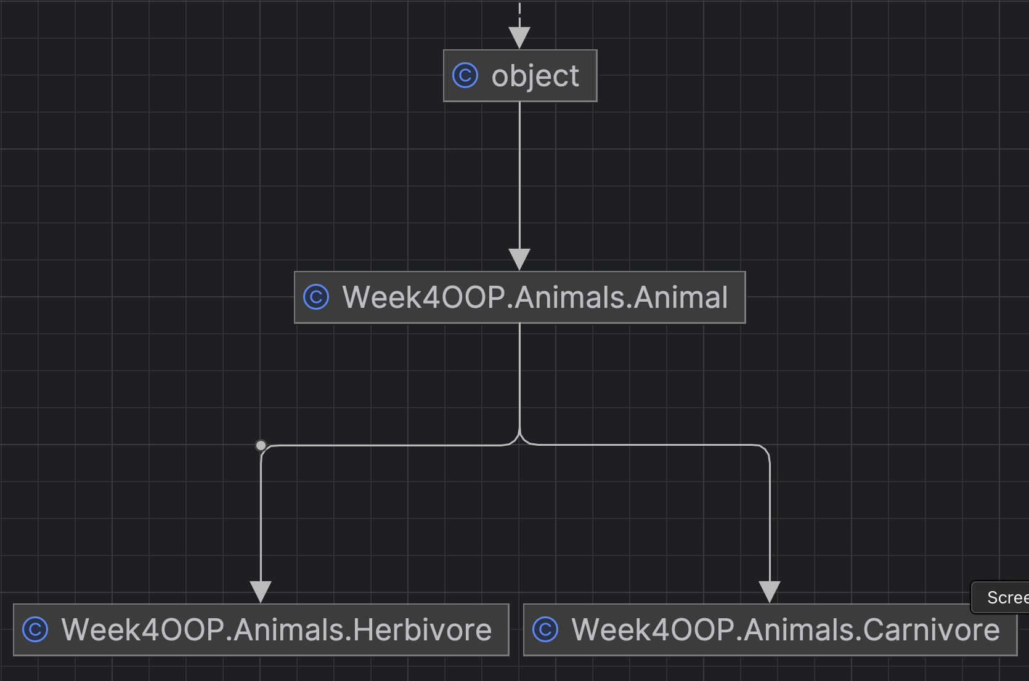
Inheritance Hierarchy
Animal is base, parent, super class
Herbivore and Carnivore are both derived, child, sub-classes of Animal.
Animal/all classes inherit from the cosmic super class object in Python which has default implementations of __str__() and other dunder methods.
e.g. <__main__.Vehicle object at 0x79e821147b60>

Slide 31
Inheritance: overriding
You've created a child class that inherits the properties and methods from its parent; awesome. However, you may have noticed a drawback: the child has no defining attributes of its own! Let's fix that. To start, add the __init__() method to the child class (instead of just pass).
class Carnivore(Animal):
def __init__(self, name, food):
self.name = name
self.food = food
As soon as the __init__() method is added, the child class will no longer inherit the parent's __init__() method. It is overridden by the child's method.
Why would you want to override? Sometimes, you may want slightly different functionality for the child class than what was provided in the parent class. In this case, overriding is actually very useful.

Slide 32
Inheritance: super duper
However: you'll notice that - at least for the constructor - you'll have to re-write the entire thing! That kind of defeats the purpose of inheritance. What if you want to keep the existing functionality of a particular method and then expand on it afterward? This is done using the super() function.
The super() function allows you to refer to the parent class directly within the child class. This is handy if you still want to use some of the inherited functionality but then expand on it. When used smartly, it is also good programming practice!
You can update and improve the Carnivore class using super() power:
class Carnivore(Animal):
def __init__(self, name, food):
super().__init__(name)
self.food = food
# note how data is passed to the parent
# also see MRO (Method Resolution Order)
tiger = Carnivore('Tiger', 'Meat')

Slide 33
Distinction: "is a" vs "has a"
Inheritance
A Carnivore “is a” type of Animal
class Carnivore(Animal)
An Herbivore “is a” type of Animal
class Herbivore(Animal)
A square is a type of rectangle
A rectangle is a type of Shape
Composition
An Animal ”has a” name
A Carnivore “has a” name and a food
Shape has a .getArea() method
A rectangle has a getArea() method override
A square has a getArea() method override

Slide 34
Summary of terms
Terminology:
Class
Object
Class attribute (variable)
Instance attribute
Method
Dot operator
Instantiate
Constructor
Getters and Setters
Scope
Inheritance
Overriding
Specific vocab/syntax:
class
self
pass
__init__()
__str__()
dunder
super()

